Slide 1
Memory Management

Slide 2
Background
Program must be brought into memory and placed within a process for it to be run
Input queue – collection of processes on the disk that are waiting to be brought into memory to run the program
User programs go through several steps before being run

Slide 3
Binding of Instructions and Data to Memory
Address binding of instructions and data to memory addresses can happen at three different stages
Compile time: If memory location known a priori, absolute code can be generated; must recompile code if starting location changes
Load time: Must generate relocatable code if memory location is not known at compile time
Execution time: Binding delayed until run time if the process can be moved during its execution from one memory segment to another. Need hardware support for address maps (e.g., base and limit registers).

Slide 4
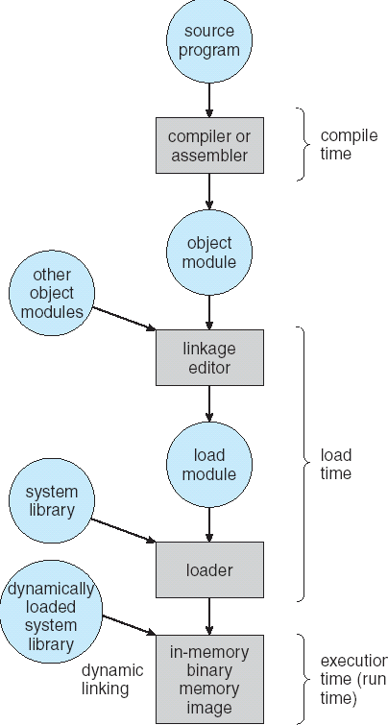
Multistep Processing of a User Program

Slide 5
Logical vs. Physical Address Space
The concept of a logical address space that is bound to a separate physical address space is central to proper memory management
Logical address – generated by the CPU; also referred to as virtual address
Physical address – address seen by the memory unit
Logical and physical addresses are the same in compile-time and load-time address-binding schemes; logical (virtual) and physical addresses differ in execution-time address-binding scheme

Slide 6
Memory-Management Unit (MMU)
Hardware device that maps virtual to physical address
In MMU scheme, the value in the relocation register is added to every address generated by a user process at the time it is sent to memory
The user program deals with logical addresses; it never sees the real physical addresses

Slide 7
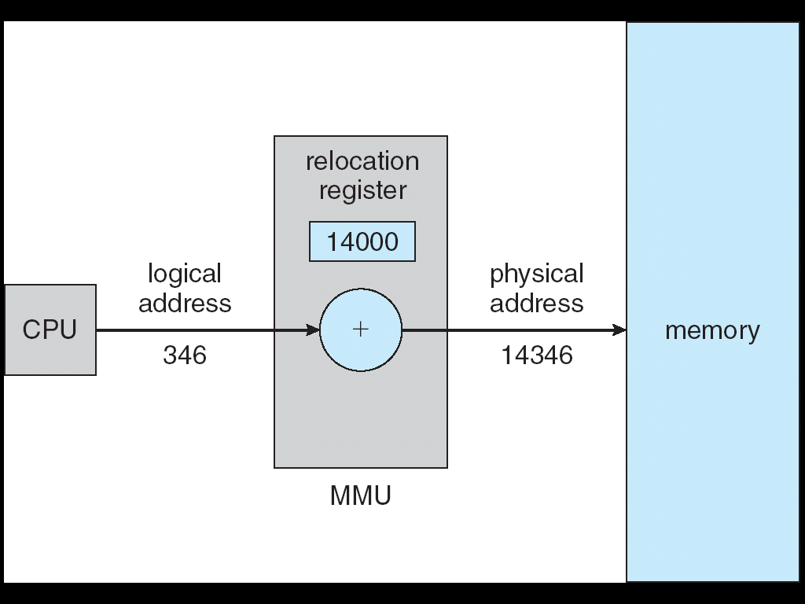
Dynamic relocation using a relocation register

Slide 8
Dynamic Loading
Routine is not loaded until it is called
Better memory-space utilization; unused routine is never loaded
Useful when large amounts of code are needed to handle infrequently occurring cases
No special support from the operating system is required implemented through program design

Slide 9
Dynamic Linking
Linking postponed until execution time
Small piece of code, stub, used to locate the appropriate memory-resident library routine
Stub replaces itself with the address of the routine, and executes the routine
Operating system needed to check if routine is in processes’ memory address
Dynamic linking is particularly useful for libraries

Slide 10
Overlays
Keep in memory only those instructions and data that are needed at any given time
Needed when process is larger than amount of memory allocated to it
Implemented by user, no special support needed from operating system, programming design of overlay structure is complex

Slide 11
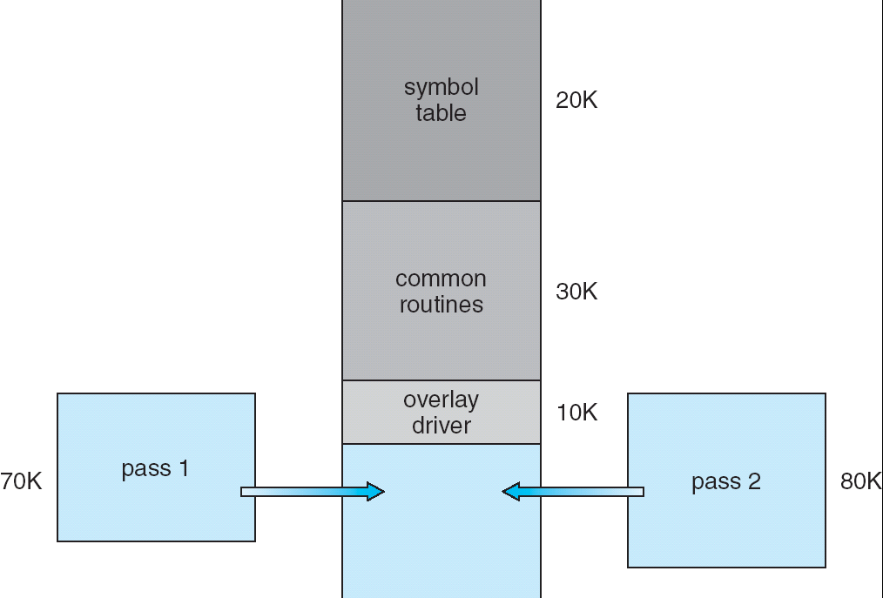
Overlays for a Two-Pass Assembler

Slide 12
Swapping
A process can be swapped temporarily out of memory to a backing store, and then brought back into memory for continued execution
Backing store – fast disk large enough to accommodate copies of all memory images for all users; must provide direct access to these memory images
Roll out, roll in – swapping variant used for priority-based scheduling algorithms; lower-priority process is swapped out so higher-priority process can be loaded and executed
Major part of swap time is transfer time; total transfer time is directly proportional to the amount of memory swapped
Modified versions of swapping are found on many systems (i.e., UNIX, Linux, and Windows)

Slide 13
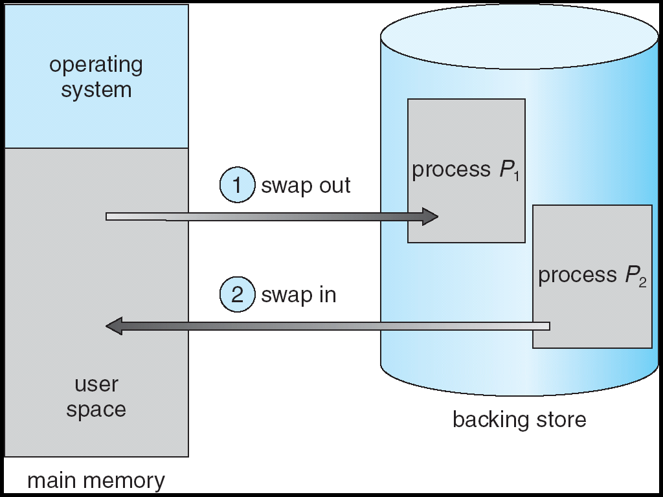
Schematic View of Swapping

Slide 14
Contiguous Allocation
Main memory usually into two partitions:
Resident operating system, usually held in low memory with interrupt vector
User processes then held in high memory
Relocation-register scheme used to protect user processes from each other, and from changing operating-system code and data
Relocation register contains value of smallest physical address; limit register contains range of logical addresses – each logical address must be less than the limit register

Slide 15
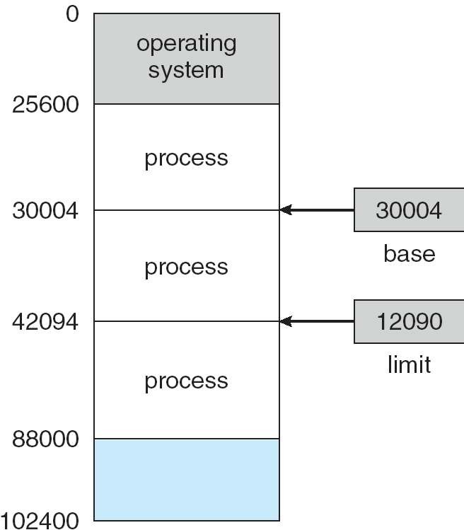
A base and a limit register define a logical address space

Slide 16
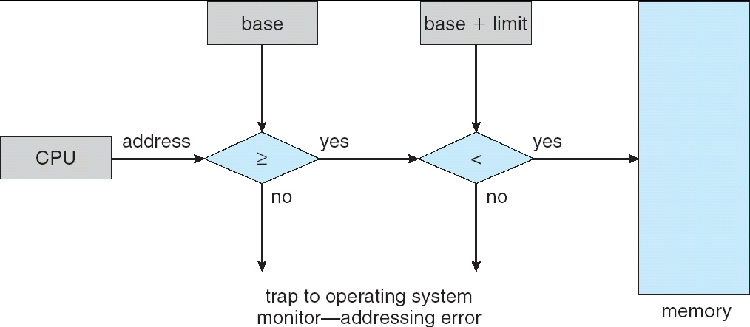
HW address protection with base and limit registers

Slide 17
Contiguous Allocation (Cont.)
Multiple-partition allocation
Hole – block of available memory; holes of various size are scattered throughout memory
When a process arrives, it is allocated memory from a hole large enough to accommodate it
Operating system maintains information about: a) allocated partitions b) free partitions (hole)
OS
OS
OS
OS
process 5
process 5
process 5
process 5
process 9
process 9
process 8
process 10
process 2
process 2
process 2
process 2

Slide 18
Dynamic Storage-Allocation Problem
How to satisfy a request of size n from a list of free holes
First-fit: Allocate the first hole that is big enough
Best-fit: Allocate the smallest hole that is big enough; must search entire list, unless ordered by size. Produces the smallest leftover hole.
Worst-fit: Allocate the largest hole; must also search entire list. Produces the largest leftover hole.
First-fit and best-fit better than worst-fit in terms of speed and storage utilization

Slide 19
Fragmentation
External Fragmentation – total memory space exists to satisfy a request, but it is not contiguous
Internal Fragmentation – allocated memory may be slightly larger than requested memory; this size difference is memory internal to a partition, but not being used
Reduce external fragmentation by compaction
Shuffle memory contents to place all free memory together in one large block
Compaction is possible only if relocation is dynamic, and is done at execution time

Slide 20
Paging
Logical address space of a process can be noncontiguous; process is allocated physical memory whenever the latter is available
Divide physical memory into fixed-sized blocks called frames (size is power of 2, between 512 bytes and 8192 bytes)
Divide logical memory into blocks of same size called pages.
Keep track of all free frames
To run a program of size n pages, need to find n free frames and load program
Set up a page table to translate logical to physical addresses
Internal fragmentation

Slide 21
Address Translation Scheme
Address generated by CPU is divided into:
Page number (p) – used as an index into a page table which contains base address of each page in physical memory
Page offset (d) – combined with base address to define the physical memory address that is sent to the memory unit
For given logical address space 2^{m} and page size 2^{n}

Slide 22
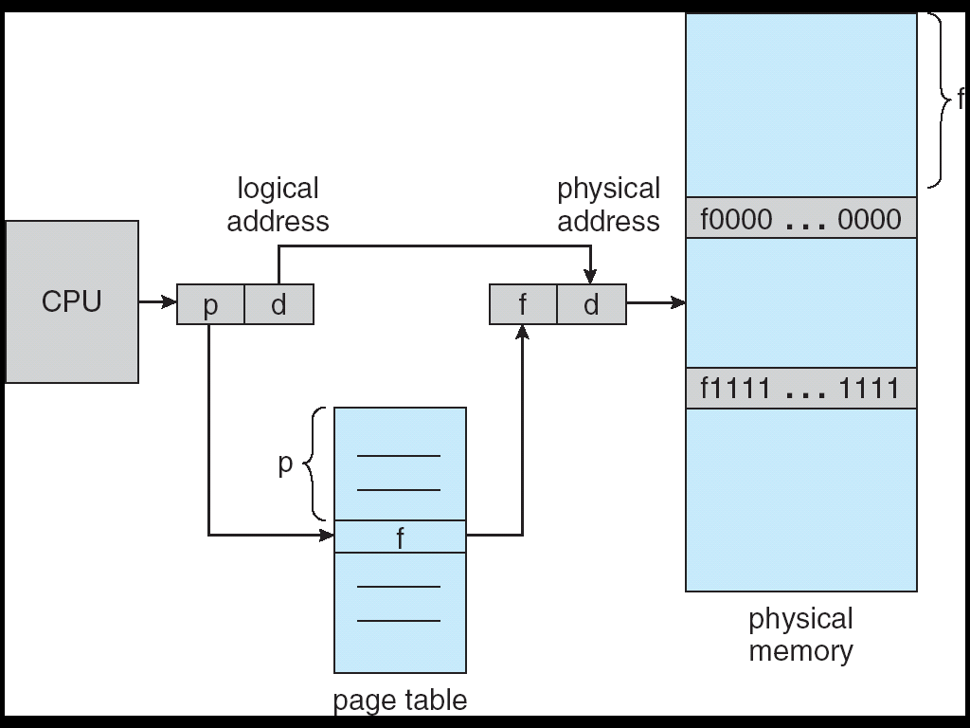
Address Translation Architecture

Slide 23
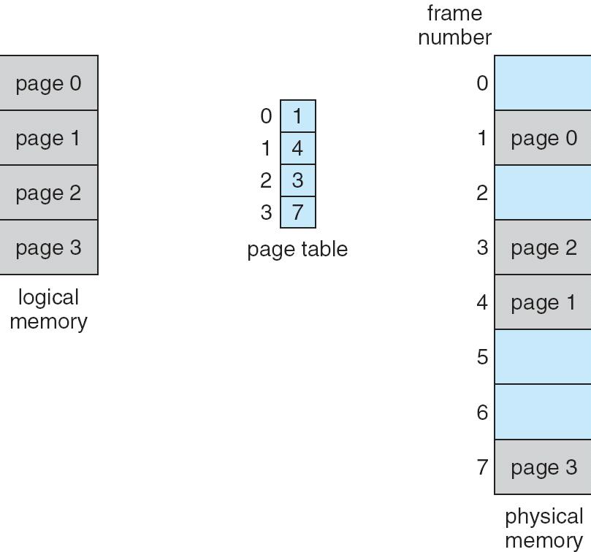
Paging Example

Slide 24
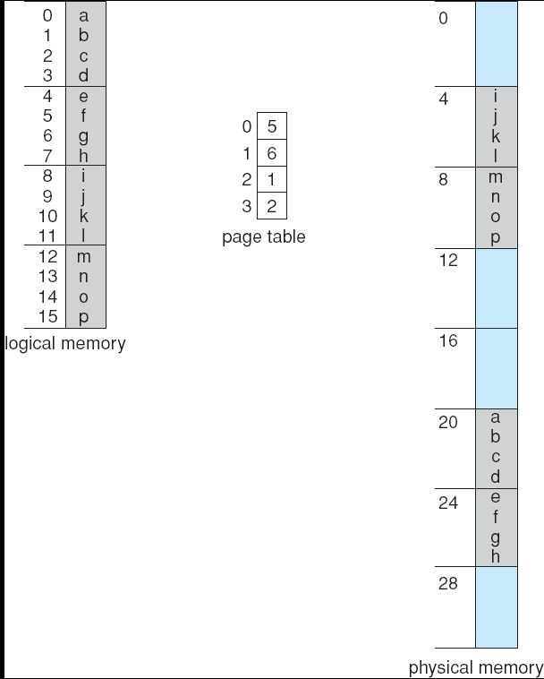
Paging Example
Page Size - 4 Bytes
Physical memory – 32 bytes

Slide 25
Calculating internal fragmentation
Page size = 2,048 bytes
Process size = 72,766 bytes
35 pages + 1,086 bytes
Internal fragmentation of 2,048 - 1,086 = 962 bytes
Worst case fragmentation = 1 frame – 1 byte
On average fragmentation = 1 / 2 frame size
So small frame sizes desirable?
But each page table entry takes memory to track
Page sizes growing over time
Solaris supports two page sizes – 8 KB and 4 MB
Process view and physical memory now very different
By implementation process can only access its own memory

Slide 26
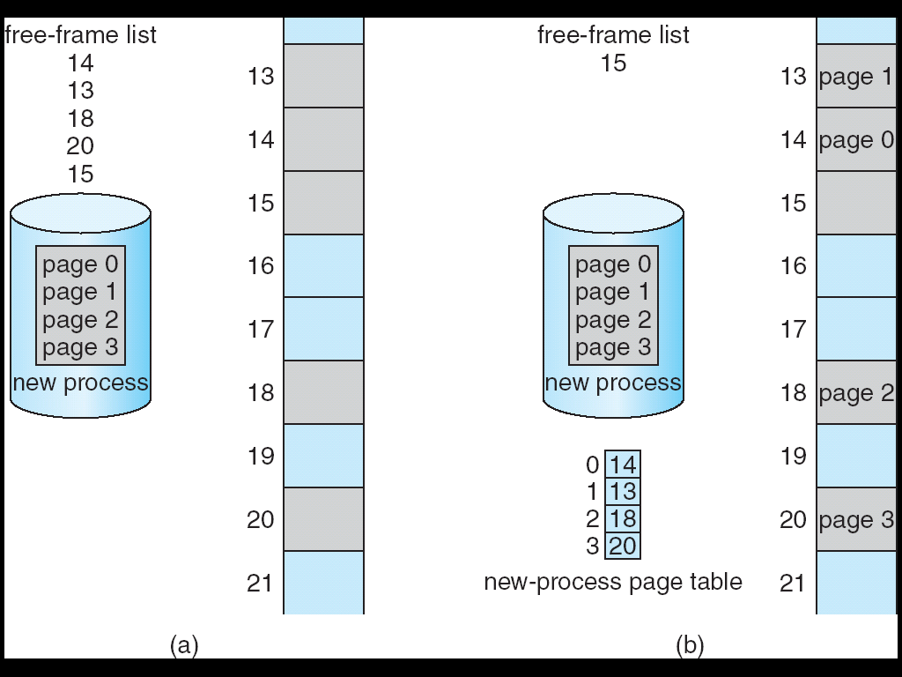
Free Frames
Before allocation
After allocation

Slide 27
Implementation of Page Table
Page table is kept in main memory
Page-table base register (PTBR) points to the page table
Page-table length register (PRLR) indicates size of the page table
In this scheme every data/instruction access requires two memory accesses. One for the page table and one for the data/instruction.
The two memory access problem can be solved by the use of a special fast-lookup hardware cache called associative memory or translation look-aside buffers (TLBs)

Slide 28
Implementation of Page Table (Cont.)
Some TLBs store address-space identifiers (ASIDs) in each TLB entry – uniquely identifies each process to provide address-space protection for that process
Otherwise need to flush at every context switch
TLBs typically small (64 to 1,024 entries)
On a TLB miss, value is loaded into the TLB for faster access next time
Replacement policies must be considered
Some entries can be wired down for permanent fast access

Slide 29
Associative Memory
Associative memory – parallel search
Address translation (A´, A´´)
If A´ is in associative register, get frame # out
Otherwise get frame # from page table in memory
Page #
Frame #

Slide 30
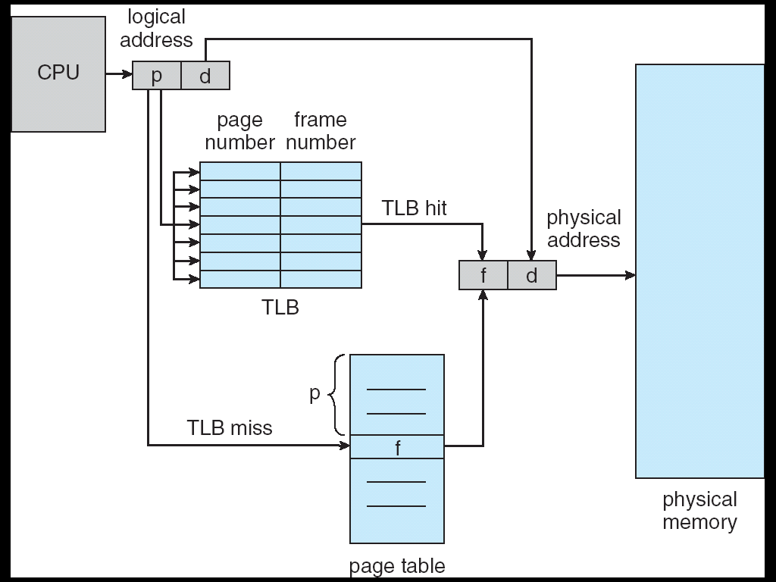
Paging Hardware With TLB

Slide 31
Effective Access Time
Hit ratio – percentage of times that a page number is found in the associative registers; ration related to number of associative registers
Effective Access Time
Consider α = 80%, ε = 20ns for TLB search, 100ns for memory access
EAT = 0.80 x (100+20) + 0.20 x 200 = 136ns
Consider more realistic hit ratio -> α = 99%, ε = 20ns for TLB search, 100ns for memory access
EAT = 0.99 x (100+20) + 0.01 x 200 = 120.8ns

Slide 32
Memory Protection
Memory protection implemented by associating protection bit with each frame
Valid-invalid bit attached to each entry in the page table:
“valid” indicates that the associated page is in the process’ logical address space, and is thus a legal page
“invalid” indicates that the page is not in the process’ logical address space

Slide 33
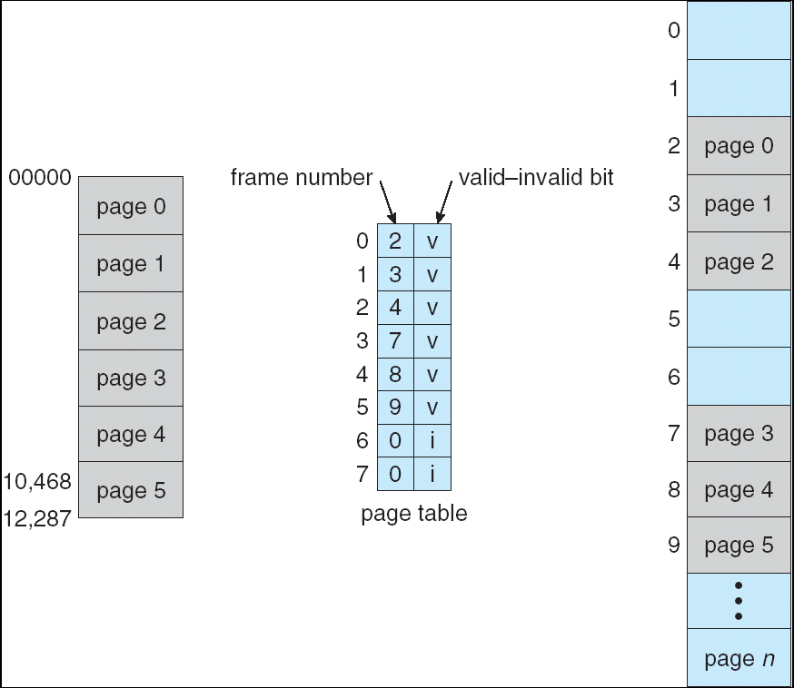
Valid (v) or Invalid (i) Bit In A Page Table

Slide 34
Shared Pages
Shared code
One copy of read-only (reentrant) code shared among processes (i.e., text editors, compilers, window systems)
Similar to multiple threads sharing the same process space
Also useful for interprocess communication if sharing of read-write pages is allowed
Private code and data
Each process keeps a separate copy of the code and data
The pages for the private code and data can appear anywhere in the logical address space

Slide 35
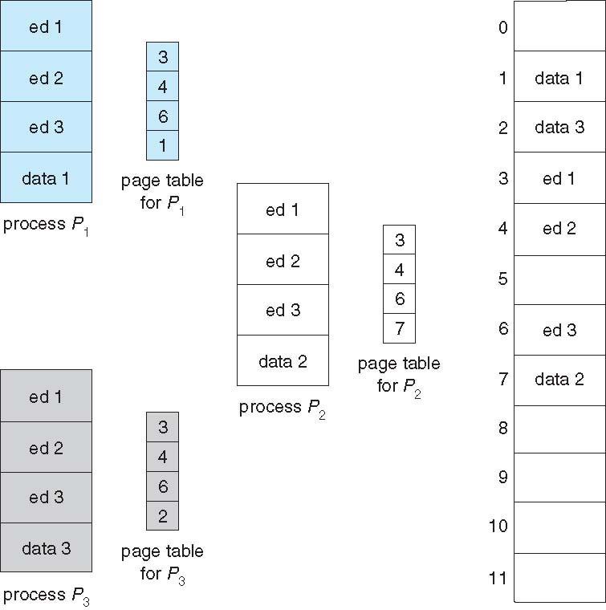
Shared Pages Example

Slide 36
Structure of the Page Table
Memory structures for paging can get huge using straight-forward methods
Consider a 32-bit logical address space as on modern computers
Page size of 4 KB (2¹²)
Page table would have 1 million entries (2³² / 2¹²)
If each entry is 4 bytes -> 4 MB of physical address space / memory for page table alone
That amount of memory used to cost a lot
Don’t want to allocate that contiguously in main memory

Slide 37
Page Table Structure
Hierarchical Paging
Hashed Page Tables
Inverted Page Tables

Slide 38
Hierarchical Page Tables
Break up the logical address space into multiple page tables
A simple technique is a two-level page table

Slide 39
Two-Level Paging Example
A logical address (on 32-bit machine with 4K page size) is divided into:
a page number consisting of 20 bits
a page offset consisting of 12 bits
Since the page table is paged, the page number is further divided into:
a 10-bit page number
a 10-bit page offset
Thus, a logical address is as follows:
where p_{i} is an index into the outer page table, and p₂ is the displacement within the page of the outer page table
page number
page offset
p_{i}
p₂
d
10
10
12

Slide 40
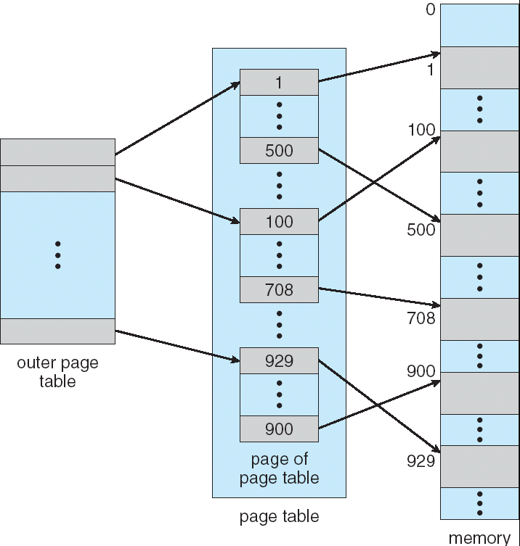
Two-Level Page-Table Scheme

Slide 41
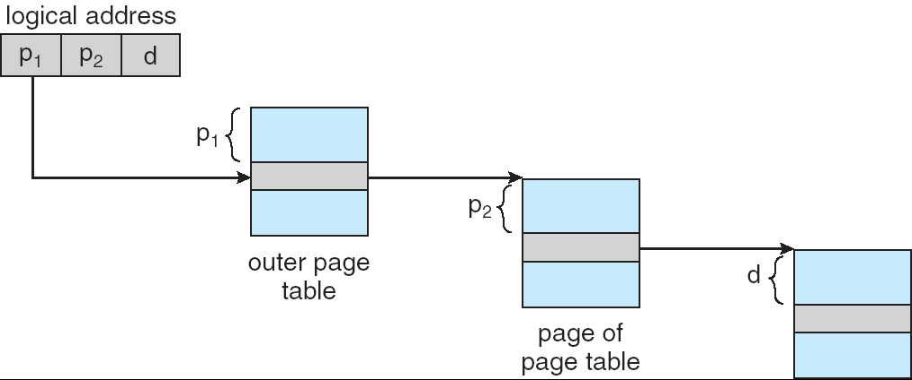
Address-Translation Scheme
Address-translation scheme for a two-level 32-bit paging architecture

Slide 42
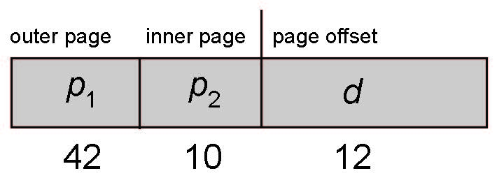
64-bit Logical Address Space
Even two-level paging scheme not sufficient
If page size is 4 KB (2¹²)
Then page table has 2⁵² entries
If two level scheme, inner page tables could be 2¹⁰ 4-byte entries
Address would look like
Outer page table has 2⁴² entries or 2⁴⁴ bytes
One solution is to add a 2nd outer page table
But in the following example the 2nd outer page table is still 2³⁴ bytes in size
And possibly 4 memory access to get to one physical memory location

Slide 43
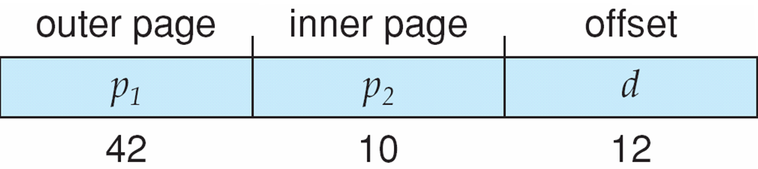
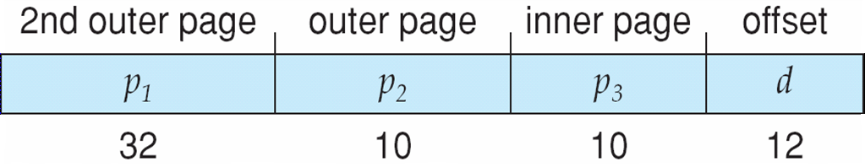
Three-level Paging Scheme

Slide 44
Hashed Page Tables
Common in address spaces > 32 bits
The virtual page number is hashed into a page table. This page table contains a chain of elements hashing to the same location.
Virtual page numbers are compared in this chain searching for a match. If a match is found, the corresponding physical frame is extracted.

Slide 45
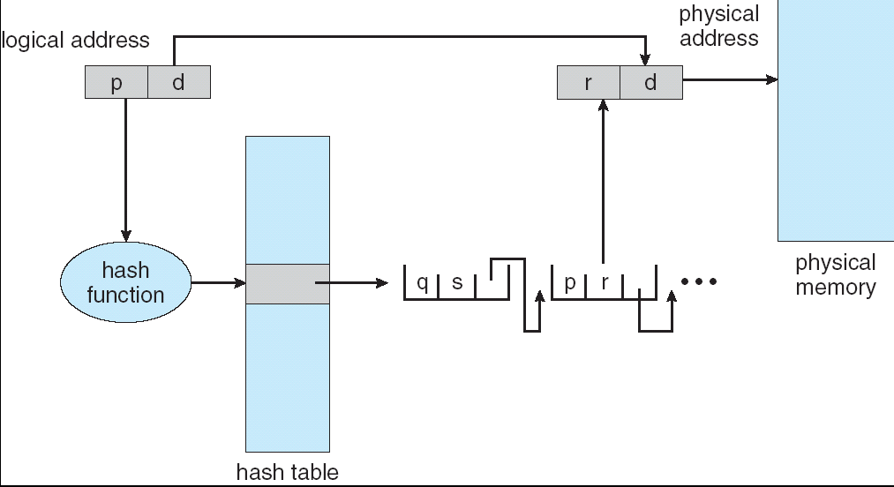
Hashed Page Table

Slide 46
Inverted Page Table
One entry for each real page of memory
Entry consists of the virtual address of the page stored in that real memory location, with information about the process that owns that page
Decreases memory needed to store each page table, but increases time needed to search the table when a page reference occurs
Use hash table to limit the search to one — or at most a few — page-table entries

Slide 47
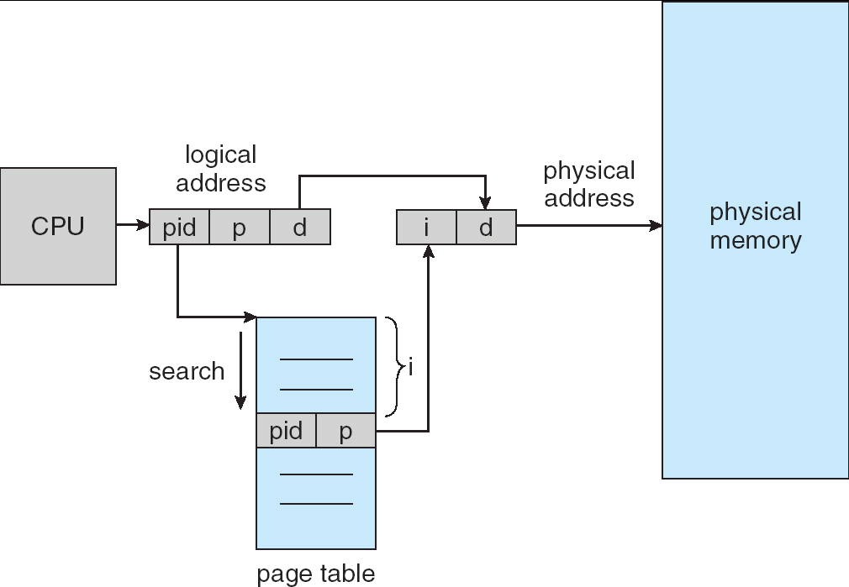
Inverted Page Table Architecture

Slide 48
Segmentation
Memory-management scheme that supports user view of memory
A program is a collection of segments. A segment is a logical unit such as:
main program,
procedure,
function,
method,
object,
local variables, global variables,
common block,
stack,
symbol table, arrays

Slide 49
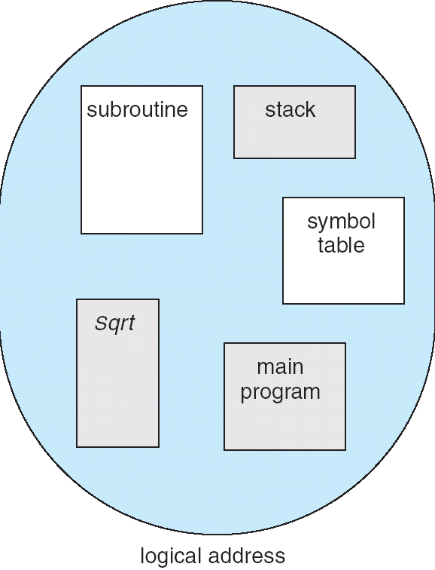
User’s View of a Program

Slide 50
Logical View of Segmentation
1
1
4
2
3
4
2
3
user space
physical memory space

Slide 51
Segmentation Architecture
Logical address consists of a two tuple:
<segment-number, offset>,
Segment table – maps two-dimensional physical addresses; each table entry has:
base – contains the starting physical address where the segments reside in memory
limit – specifies the length of the segment
Segment-table base register (STBR) points to the segment table’s location in memory
Segment-table length register (STLR) indicates number of segments used by a program;segment number s is legal if s < STLR

Slide 52
Segmentation Architecture (Cont.)
Relocation.
dynamic
by segment table
Sharing.
shared segments
same segment number
Allocation.
first fit/best fit
external fragmentation

Slide 53
Segmentation Architecture (Cont.)
Protection. With each entry in segment table associate:
read/write/execute privileges
Protection bits associated with segments; code sharing occurs at segment level
Since segments vary in length, memory allocation is a dynamic storage-allocation problem
A segmentation example is shown in the following diagram

Slide 54
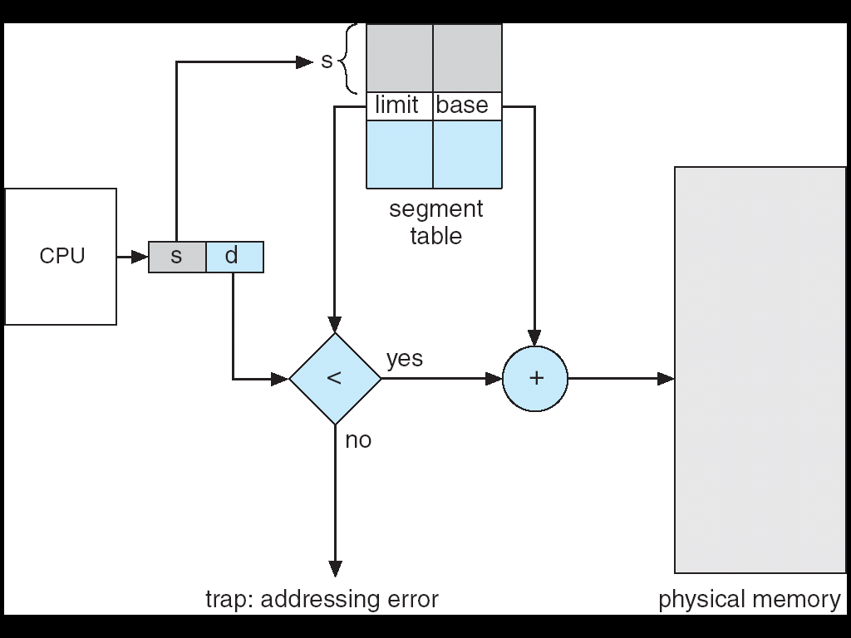
Address Translation Architecture

Slide 55
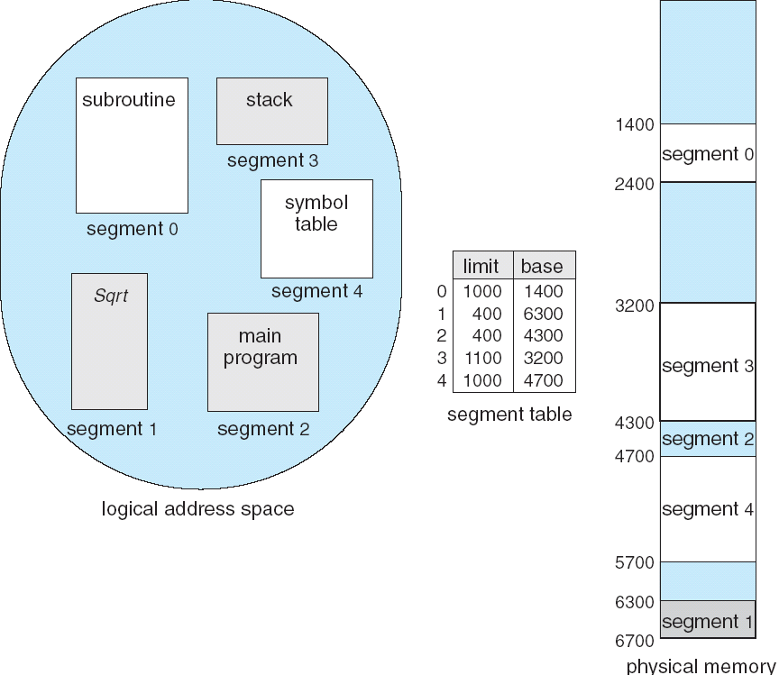
Example of Segmentation

Slide 56
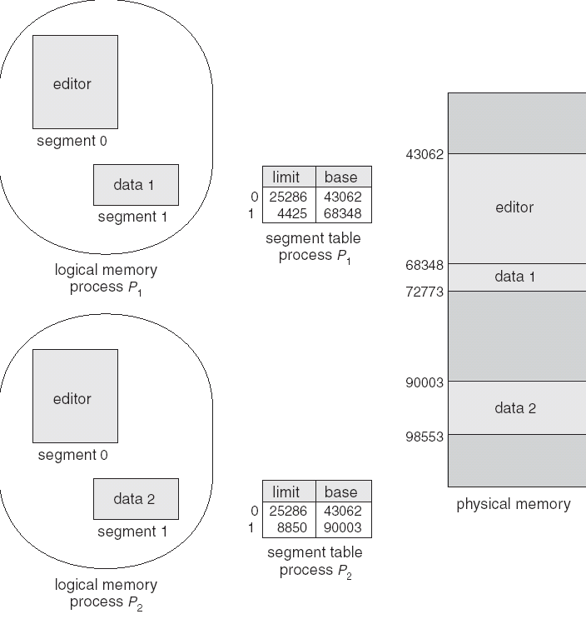
Sharing of Segments

Slide 57
Segmentation with Paging
Combine two to improve on each
Logical address space is divided into two partitions
First partition contains segments private to that process
Second partition contains segments shared among processes
Information about the first partition is kept in the Local Descriptor Table(LDT)
Information about the second partition is kept in the Global Descriptor Table(GDT)
Logical Address is a pair (Selector, offset)
s | g | p
13 | 1 | 2

Slide 58
Segmentation with Paging – MULTICS
The MULTICS system solved problems of external fragmentation and lengthy search times by paging the segments.
Solution differs from pure segmentation in that the segment-table entry contains not the base address of the segment, but rather the base address of a page table for this segment.

Slide 59
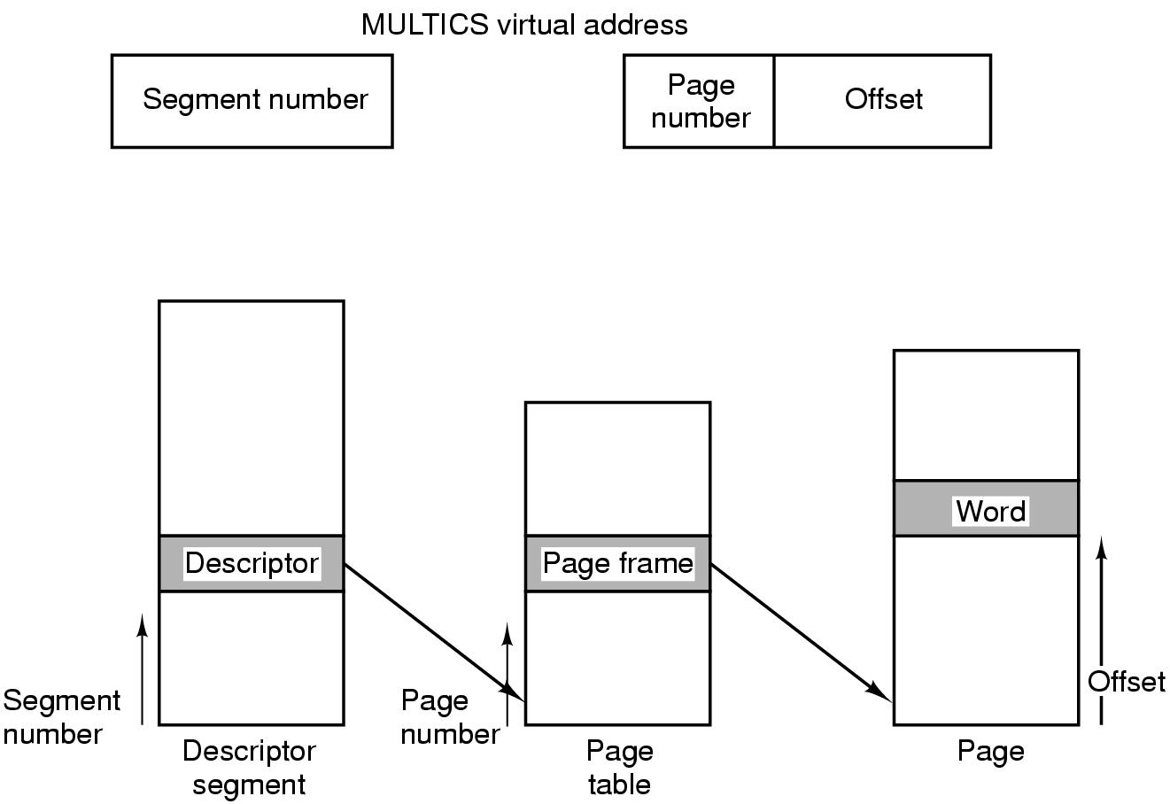
Segmentation with Paging: MULTICS

Slide 60
Segmentation with Paging – Intel 386
As shown in the following diagram, the Intel 386 uses segmentation with paging for memory management with a two-level paging scheme

Slide 61
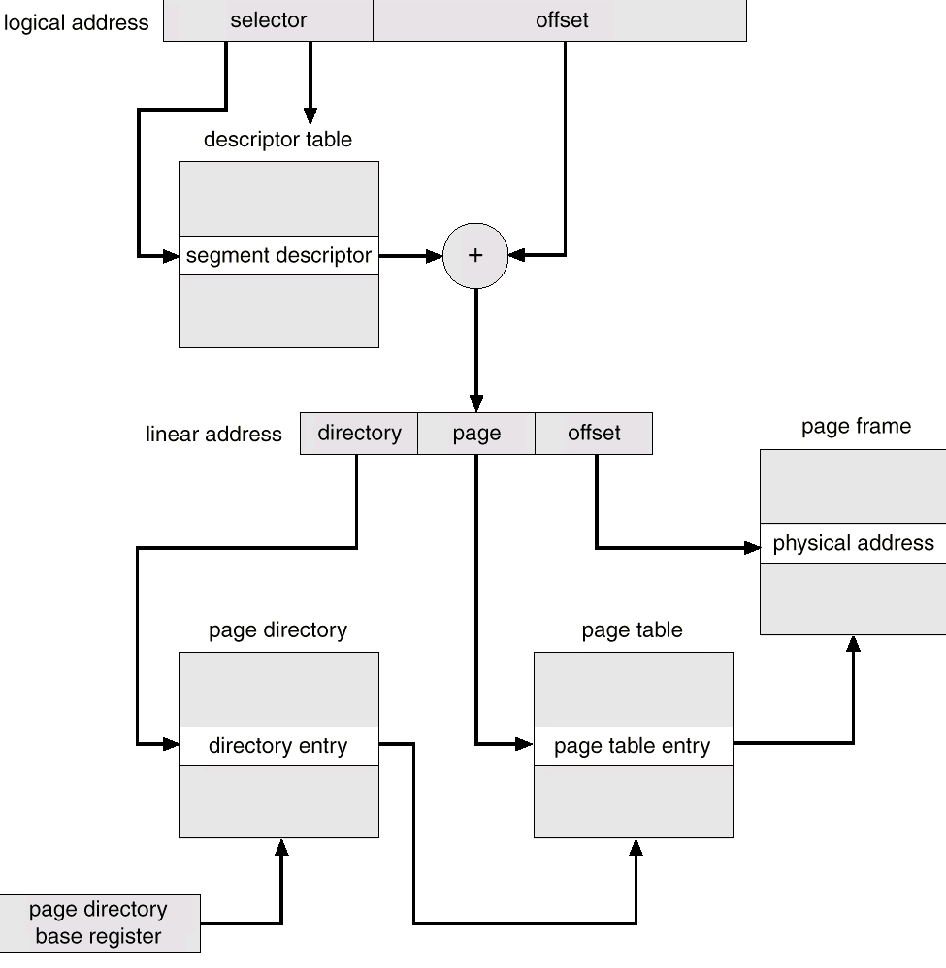
Intel 30386 Address Translation

Slide 62
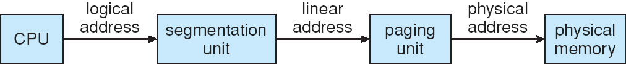
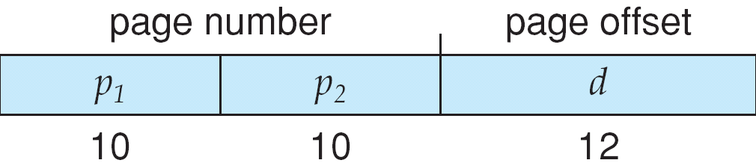
Logical to Physical Address Translation in Pentium

Slide 63
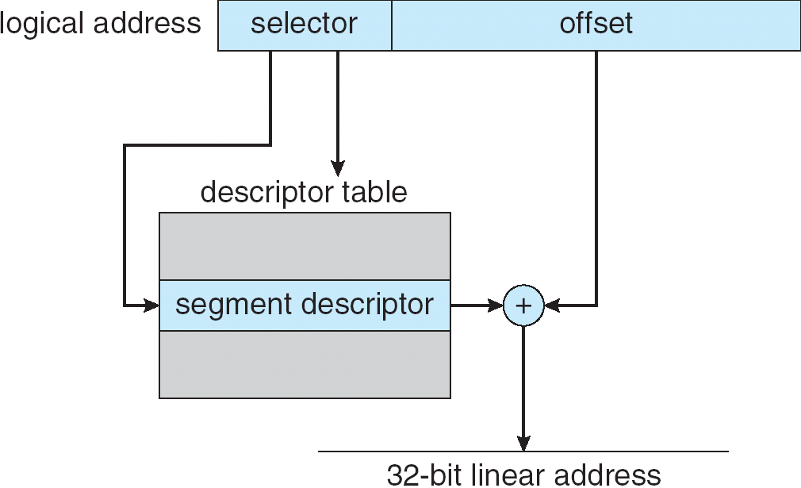
Intel Pentium Segmentation

Slide 64
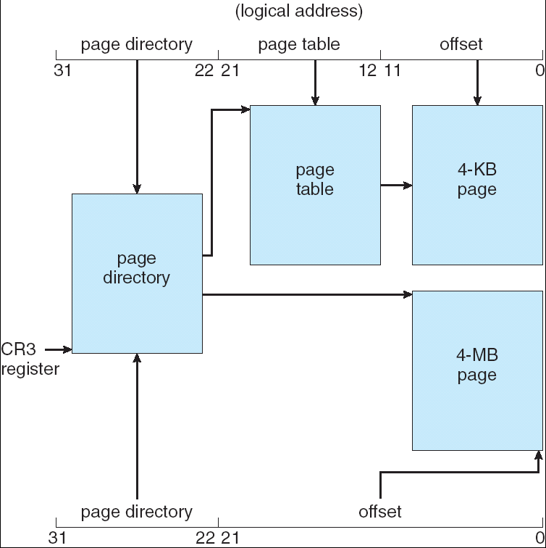
Pentium Paging Architecture

Slide 65
Virtual Memory

Slide 66

Background
Virtual memory – separation of user logical memory from physical memory.
Only part of the program needs to be in memory for execution.
Logical address space can therefore be much larger than physical address space.
Allows address spaces to be shared by several processes.
Allows for more efficient process creation.
Virtual memory can be implemented via:
Demand paging
Demand segmentation

Slide 67
Demand Paging
Bring a page into memory only when it is needed
Less memory needed
Faster response
More users
Page is needed ⇒ reference to it
invalid reference ⇒ abort
not-in-memory ⇒ bring to memory

Slide 68
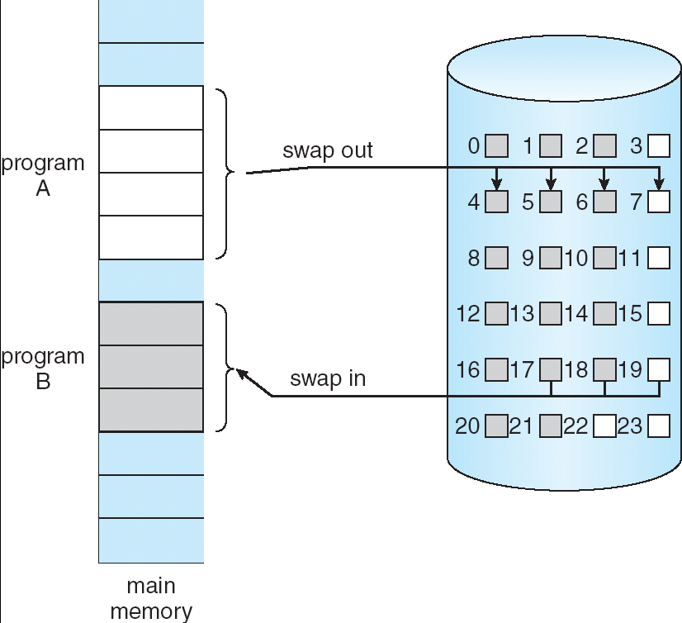
Transfer of a Paged Memory to Contiguous Disk Space

Slide 69
Valid-Invalid Bit
With each page table entry a valid–invalid bit is associated (1 ⇒ in-memory, 0 ⇒ not-in-memory)
Initially valid–invalid but is set to 0 on all entries
Example of a page table snapshot:
During address translation, if valid–invalid bit in page table entry is 0 ⇒ page fault
Frame #
valid-invalid bit
1
1
1
1
0

0
0
page table

Slide 70
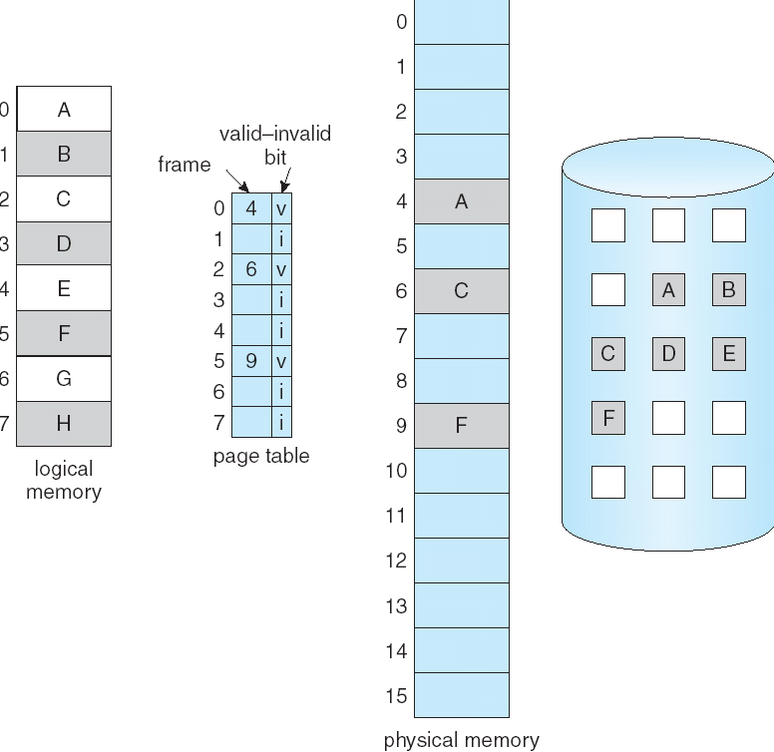
Page Table When Some Pages Are Not in Main Memory

Slide 71
Page Fault
If there is ever a reference to a page, first reference will trap to OS ⇒ page fault
OS looks at another table to decide:
Invalid reference ⇒ abort.
Just not in memory.
Get empty frame.
Swap page into frame.
Reset tables, validation bit = 1.
Restart instruction

Slide 72
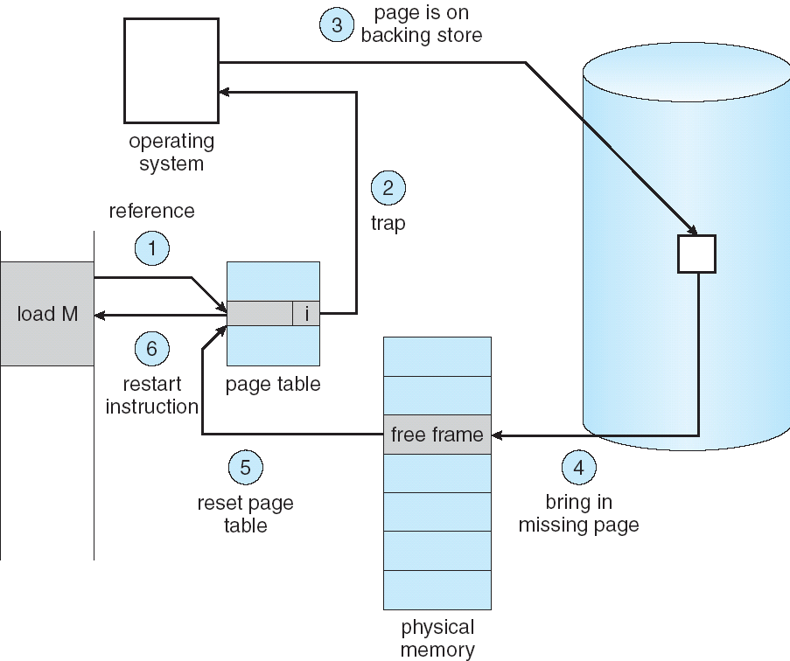
Steps in Handling a Page Fault

Slide 73
What happens if there is no free frame?
Page replacement – find some page in memory, but not really in use, swap it out
algorithm
performance – want an algorithm which will result in minimum number of page faults
Same page may be brought into memory several times

Slide 74
Performance of Demand Paging
Page Fault Rate 0 ≤ p ≤ 1.0
if p = 0 no page faults
if p = 1, every reference is a fault
Effective Access Time (EAT)
EAT = (1 – p) x memory access
+ p x page fault time
Page fault time- (page fault overhead+ [swap page out ]+ swap page in+ restart overhead)

Slide 75
Demand Paging Example
Memory access time = 100 nanosecond
Average pagefault service time=25 millisecond
EAT(ns)=(1-p) x(100) + (25 milliseconds)
= (1-p)x100+px2500000
=100+24999900 x p
EAT is directly proportional to page fault rate
If one access out of 1,000 causes a page fault, then
EAT = 25 microseconds.
This is a slowdown by a factor of 250!!

Slide 76
Process Creation
Virtual memory allows other benefits during process creation:
- Copy-on-Write
- Memory-Mapped Files

Slide 77
Copy-on-Write
Copy-on-Write (COW) allows both parent and child processes to initially share the same pages in memory. If either process modifies a shared page, only then is the page copied.
COW allows more efficient process creation as only modified pages are copied.
Free pages are allocated from a pool of zeroed-out pages.
Technique called zero-fill-on-demand.

Slide 78
Memory-Mapped Files
Memory-mapped file I/O allows file I/O to be treated as routine memory access by mapping a disk block to a page in memory.
A file is initially read using demand paging. A page-sized portion of the file is read from the file system into a physical page. Subsequent reads/writes to/from the file are treated as ordinary memory accesses.
Simplifies file access by treating file I/O through memory rather than read() write() system calls.
Also allows several processes to map the same file allowing the pages in memory to be shared.

Slide 79
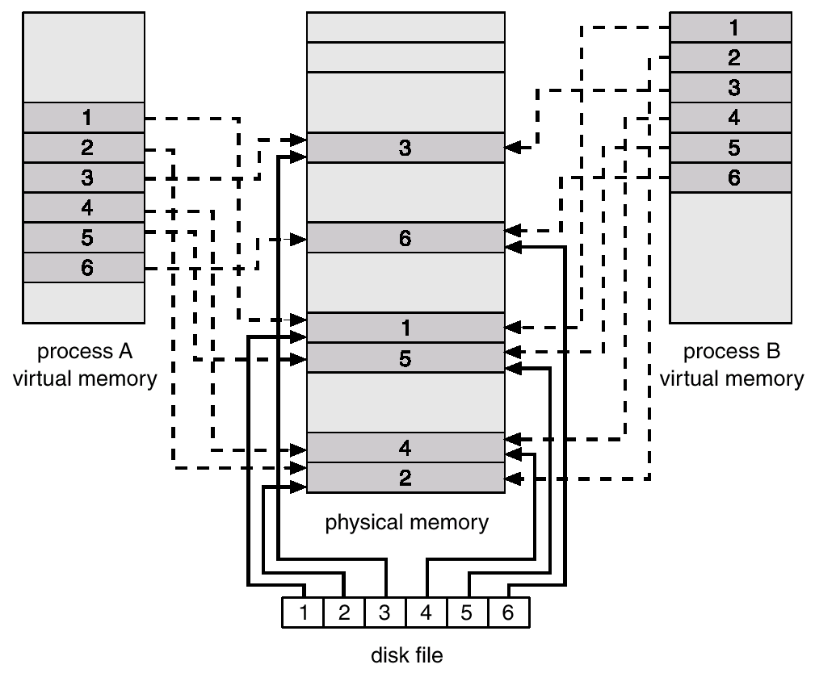
Memory Mapped Files

Slide 80
Page Replacement
Prevent over-allocation of memory by modifying page-fault service routine to include page replacement
Use modify (dirty) bit to reduce overhead of page transfers – only modified pages are written to disk
Page replacement completes separation between logical memory and physical memory – large virtual memory can be provided on a smaller physical memory

Slide 81
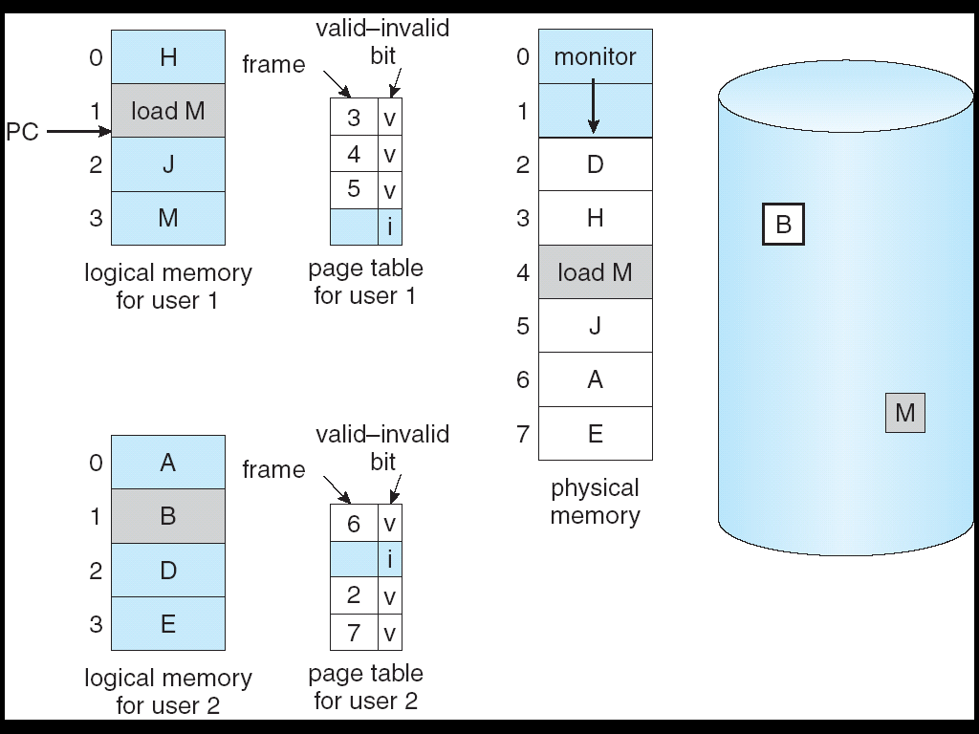
Need For Page Replacement

Slide 82
Basic Page Replacement
Find the location of the desired page on disk
Find a free frame: - If there is a free frame, use it - If there is no free frame, use a page replacement algorithm to select a victim frame
Read the desired page into the (newly) free frame. Update the page and frame tables.
Restart the process

Slide 83
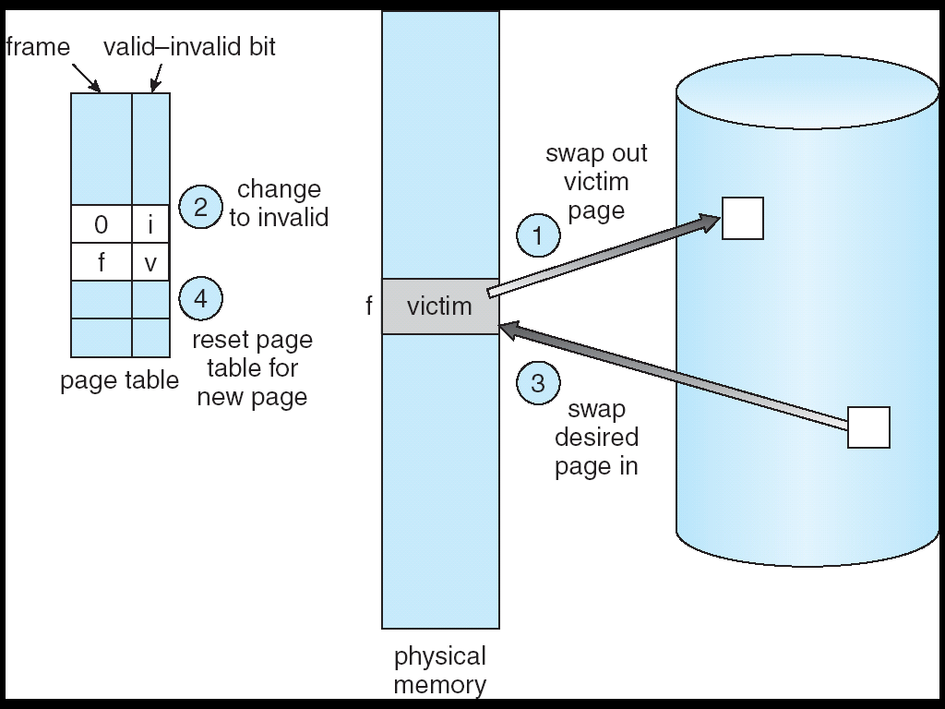
Page Replacement

Slide 84
Page Replacement Algorithms
Want lowest page-fault rate
Evaluate algorithm by running it on a particular string of memory references (reference string) and computing the number of page faults on that string
In all our examples, the reference string is
1, 2, 3, 4, 1, 2, 5, 1, 2, 3, 4, 5

Slide 85
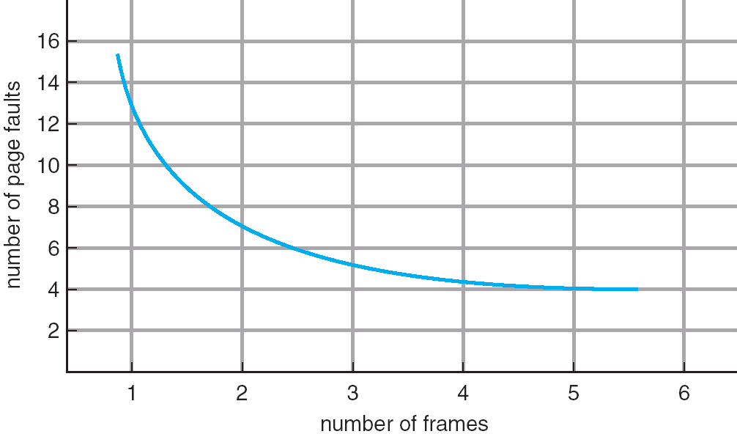
Graph of Page Faults Versus The Number of Frames

Slide 86
First-In-First-Out (FIFO) Algorithm
Reference string: 1, 2, 3, 4, 1, 2, 5, 1, 2, 3, 4, 5
3 frames (3 pages can be in memory at a time per process)
4 frames
FIFO Replacement – Belady’s Anomaly
more frames ⇒ more page faults
1
1
4
5
2
2
1
3
9 page faults
3
3
2
4
1
1
5
4
2
2
1
5
10 page faults
3
3
2
4
4
3

Slide 87
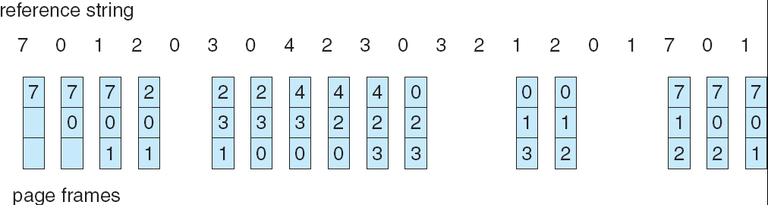
FIFO Page Replacement

Slide 88
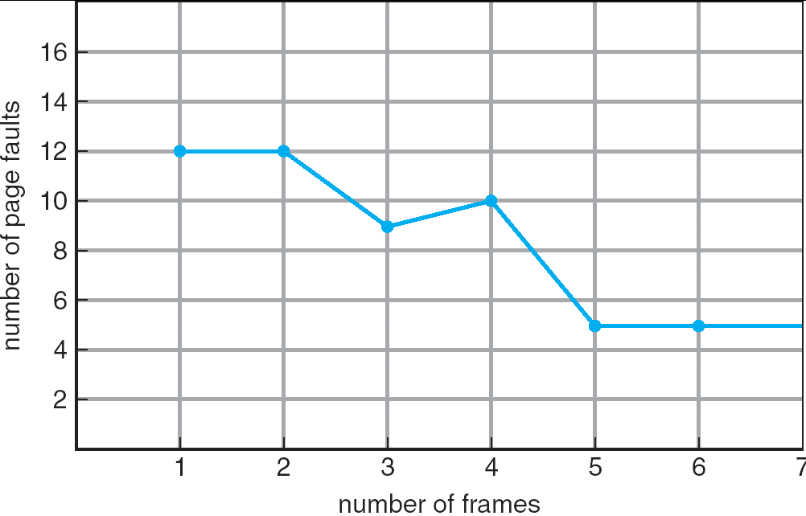
FIFO Illustrating Belady’s Anomaly

Slide 89
Optimal Algorithm
Replace page that will not be used for longest period of time
4 frames example
1, 2, 3, 4, 1, 2, 5, 1, 2, 3, 4, 5
How do you know this?
Used for measuring how well your algorithm performs
1
4
2
6 page faults
3
4
5

Slide 90
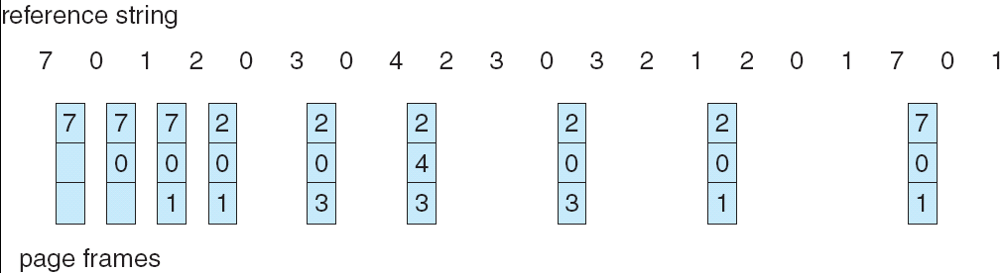
Optimal Page Replacement

Slide 91
Least Recently Used (LRU) Algorithm
Reference string: 1, 2, 3, 4, 1, 2, 5, 1, 2, 3, 4, 5
Counter implementation
Every page entry has a counter; every time page is referenced through this entry, copy the clock into the counter
When a page needs to be changed, look at the counters to determine which are to change
1
5
2
3
5
4
4
3

Slide 92
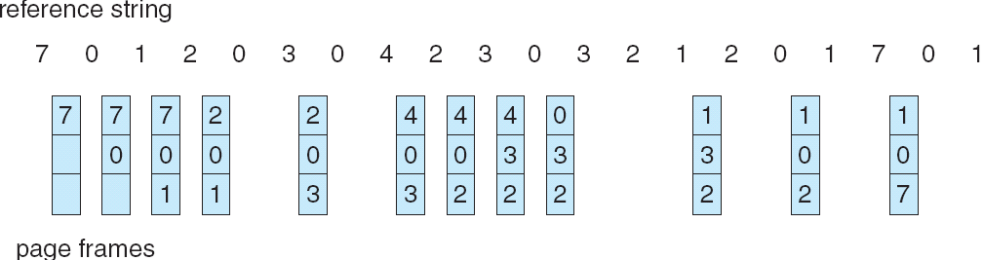
LRU Page Replacement

Slide 93
LRU Algorithm (Cont.)
Stack implementation – keep a stack of page numbers in a double link form:
Page referenced:
move it to the top
requires 6 pointers to be changed
No search for replacement

Slide 94
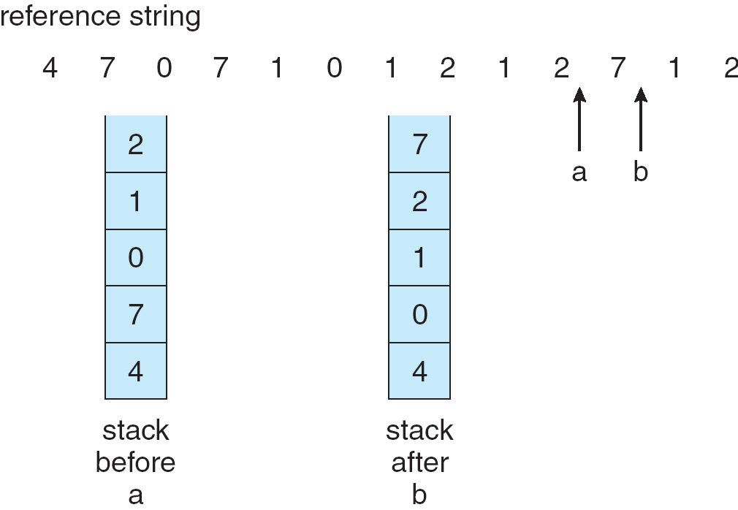
Use Of A Stack to Record The Most Recent Page References

Slide 95
LRU Approximation Algorithms
Reference bit
With each page associate a bit, initially = 0
When page is referenced bit set to 1
Replace the one which is 0 (if one exists). We do not know the order, however.
Additional Reference bits
Second chance
Enhanced Second Chance

Slide 96
Additional reference bits algorithm
An 8 bit reference bits for each page.
At regular interval update the reference bit
If the page is referenced, shift right with high order bit 1, discarding low order bit.
00000000→10000000
If the page is not referenced, shift right with high order bit 0, discarding the low order bit.
00000000→00000000
A page with lowest registry value can be selected as victim.
10000000 is recently referenced than 01111011

Slide 97
Second chance Algorithm
When a page is selected , inspect reference bit
If the value is 0, proceed to replace the page
If the value is 1, give it a second chance
Move on to the next FIFO page
When a page gets second chance, its reference bit is cleared and its arrival time is set to current time.

Slide 98
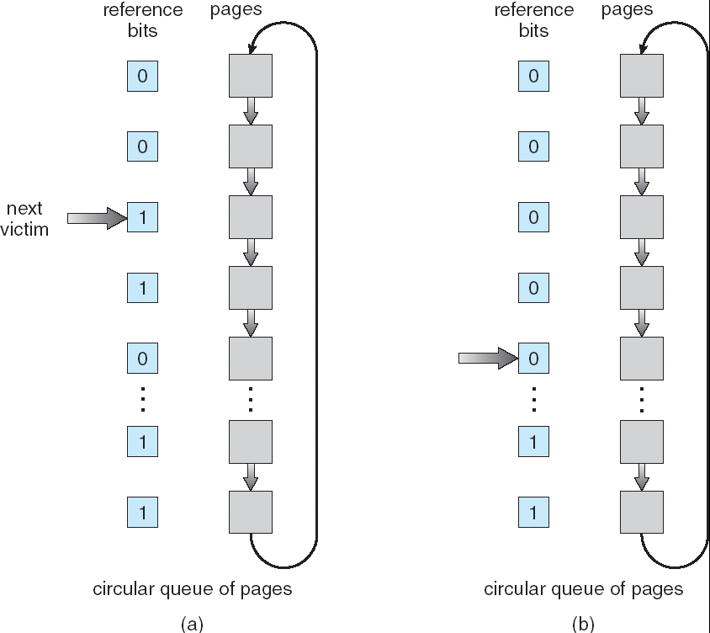
Second-Chance (clock) Page-Replacement Algorithm
Need reference bit
If page to be replaced (in clock order) has reference bit = 1 then:
set reference bit 0
leave page in memory
replace next page (in clock order), subject to same rules

Slide 99
Enhanced second chance Algorithm
Considers reference bit and modify bit pair. Four Cases:
Replaces the first page encountered in the lowest non-empty
class
Pair of bits(reference bit, modify bit)
(0,0): neither recently used, not modified: best
(0,1): not recently used, but modified: second best
(1,0): recently used; but not modified: third best
(1,1): used and modified : not replaced

Slide 100
Counting Algorithms
Keep a counter of the number of references that have been made to each page
LFU Algorithm: replaces page with smallest count
Disadvantage: page which is heavily used initially, but not currently used will have a high count compared to the recently used.
MFU Algorithm: based on the argument that the page with the smallest count was probably just brought in and has yet to be used

Slide 101
Page Buffering algorithm
Procedures used along with page replacement algorithms
Desired page is read into the frame before the victim is written out
Maintain a list of modified pages to write it back to the disk when the paging device is idle
Keep a record of which page was in each frame in the pool of free frames(used with FIFO replacement algorithm).

Slide 102
Allocation of Frames
Each process needs minimum number of pages defined by the architecture
Maximum no. is defined by the amount of available physical memory
Two major allocation schemes
fixed allocation
priority allocation

Slide 103
Fixed Allocation
Equal allocation – For example, if there are 100 frames and 5 processes, give each process 20 frames.
Proportional allocation – Allocate according to the size of process

Slide 104
Priority Allocation
Use a proportional allocation scheme using priorities rather than size
If process P_{i} generates a page fault,
select for replacement one of its frames
select for replacement a frame from a process with lower priority number

Slide 105
Global vs. Local Allocation
Global replacement – process selects a replacement frame from the set of all frames; one process can take a frame from another
Local replacement – each process selects from only its own set of allocated frames

Slide 106
Thrashing
If a process does not have “enough” pages, the page-fault rate is very high. This leads to:
low CPU utilization
operating system thinks that it needs to increase the degree of multiprogramming
another process added to the system
Thrashing ≡ a process is busy swapping pages in and out

Slide 107
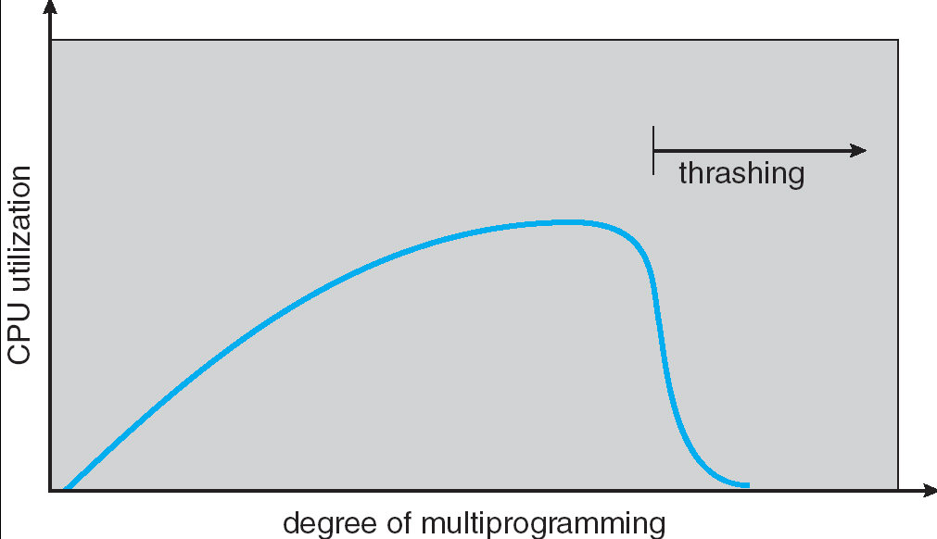
Thrashing (Cont.)

Slide 108
Effects of thrashing can be reduced by local replacement algorithm
Locality model
Process migrates from one locality to another
Localities may overlap
Why does thrashing occur? Σ size of locality > total memory size

Slide 109
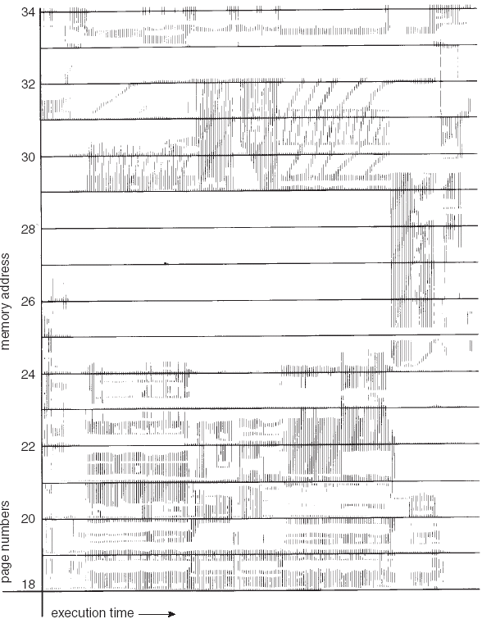
Locality In A Memory-Reference Pattern

Slide 110
Working-Set Model
Δ ≡ working-set window ≡ a fixed number of page references Example: 10,000 instruction
WSS_{i} (working set of Process P_{i}) = total number of pages referenced in the most recent Δ (varies in time)
if Δ too small will not encompass entire locality
if Δ too large will encompass several localities
if Δ = ∞ ⇒ will encompass entire program
D = Σ WSS_{i} ≡ total demand frames
if D > m ⇒ Thrashing
Policy if D > m, then suspend one of the processes

Slide 111
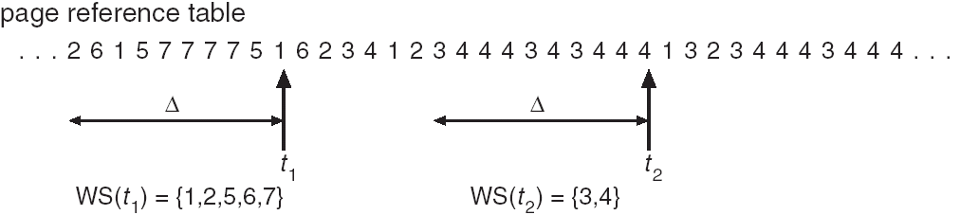
Working-set model

Slide 112
Keeping Track of the Working Set
Approximate with interval timer + a reference bit
Example: Δ = 10,000
Timer interrupts after every 5000 time units
Keep in memory 2 bits for each page
Whenever a timer interrupts copy and sets the values of all reference bits to 0
If one of the bits in memory = 1 ⇒ page in working set
Why is this not completely accurate?
Improvement = 10 bits and interrupt every 1000 time units

Slide 113
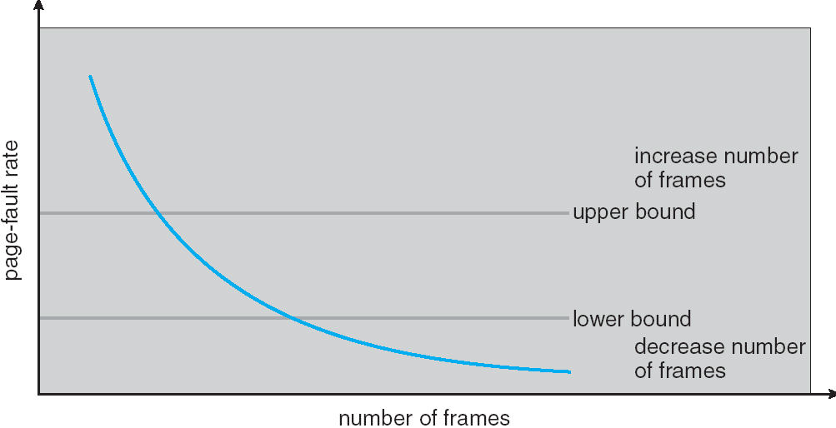
Page-Fault Frequency Scheme
Establish “acceptable” page-fault rate
If actual rate too low, process loses frame
If actual rate too high, process gains frame

